Slide 1
FAIR Assessment
Jan Taubitz

Slide 2
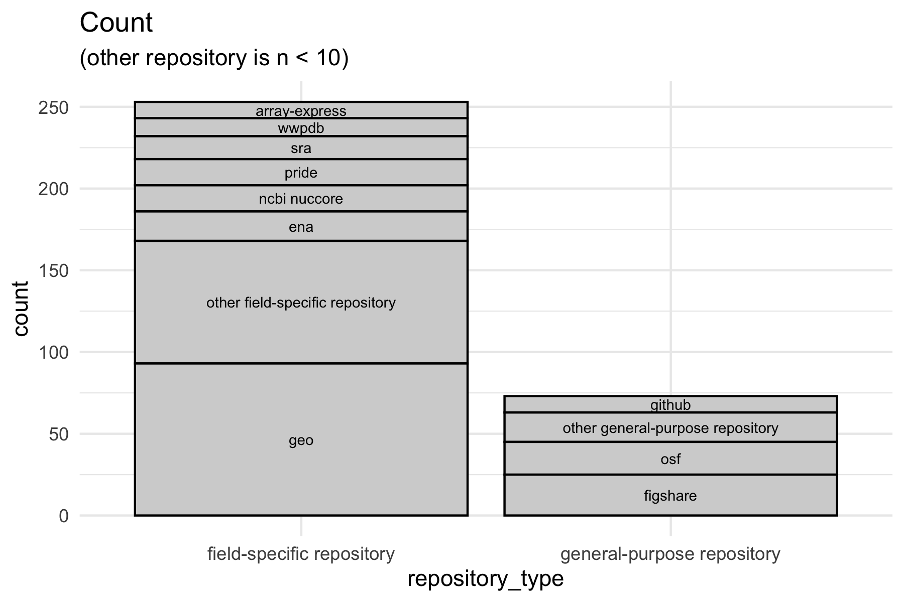
Repository Count

Slide 3
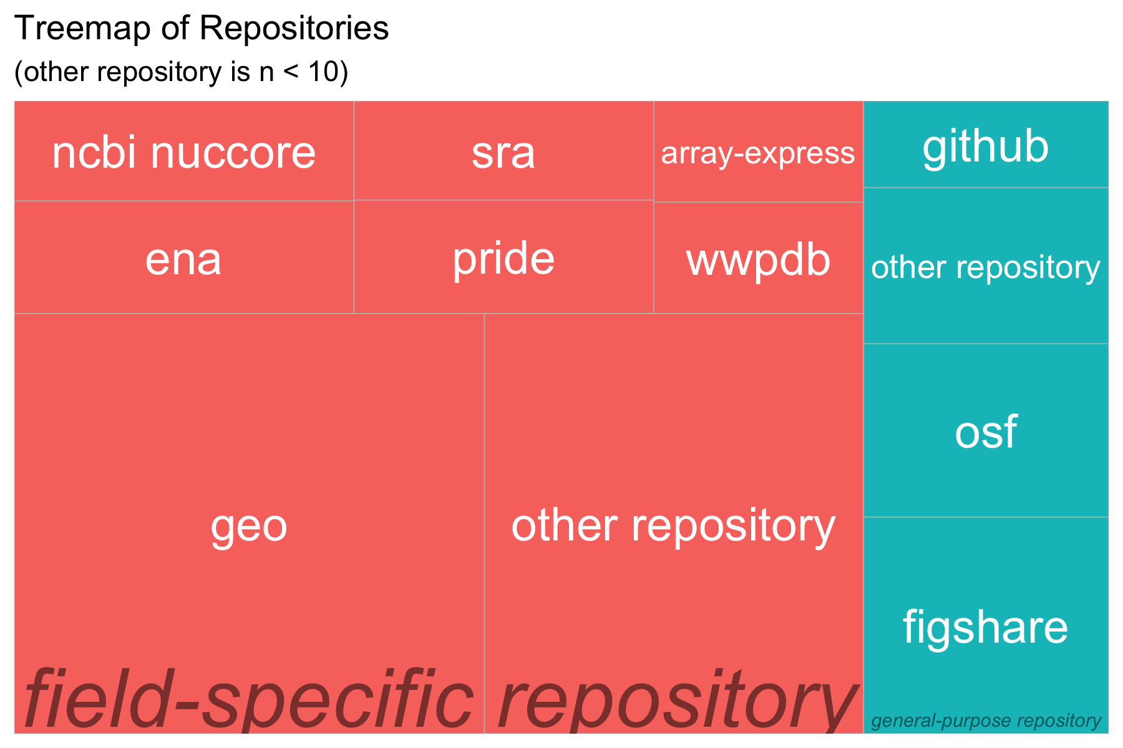
Repository Treemap

Slide 4
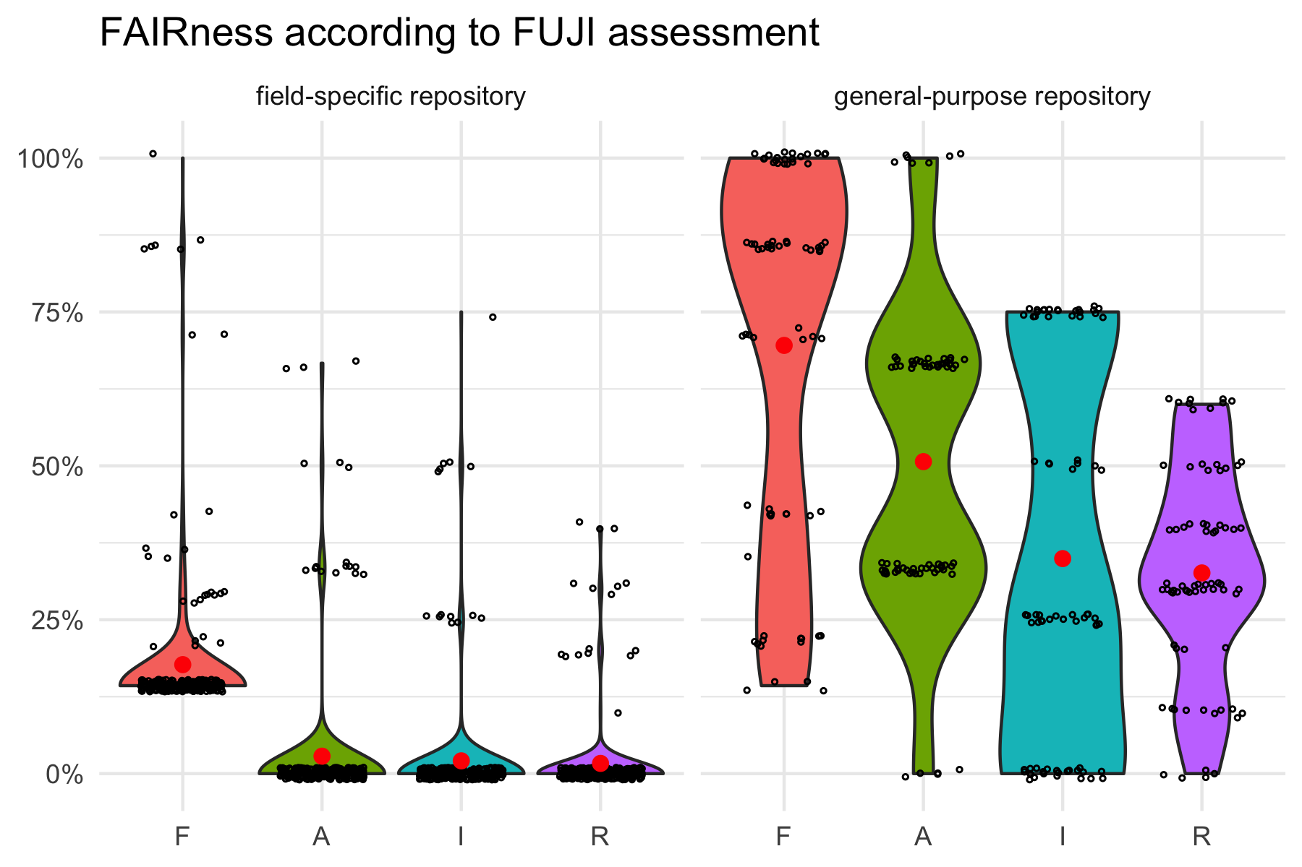
Repository Type

Slide 5
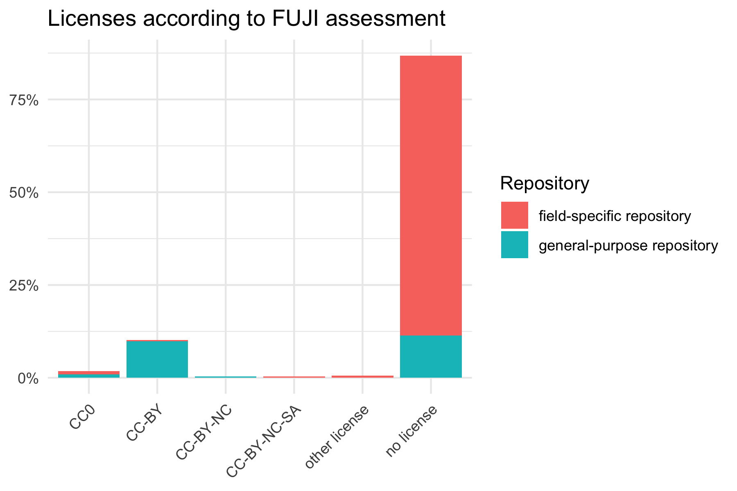
Licenses

